Slide 1
A quick update!

Slide 2
What do we do?
81 IXP Members and 13 Patrons
Two fora per year
Maintain and develop the website, database and tools
Annual European IXP Report
Mentor-IX programme
Fellowship programme
Benchmarking Club (BMC)
Newsletter – Subscribe here:
euro-ix.net/news-and-events/newsletter/
Working Groups
Social Media
Twitter @euroix
Facebook fb.me/maineuroix
YouTube youtube.com/channel/UCFyucVRAAMzxyJIsxnGwsjw

Slide 3
IXP Member Lists

Slide 4
IXP Member List JSON Schema
Contains both IXP data and IXP participant data
ASN (member list), locations, switch, RS and more to come..
Open, consistent and an atomic design
Currently 24 IXP independent implementations
(API includes data from euro-ix portal entered manually or via .csv)
Open source implementation in IXP Manager
Source available on GitHib:
https://github.com/euro-ix/json-schemas

Slide 5
IXP Database – use case
Why not use the IXPs own data?
This gives you a single API for many IXPs
Get the same format for all IXPs
Data is fed from the IXP – IXPs have the accurate data, they own it.
Portable, supportable and scale-able!

Slide 6
IXP Database
In search of accurate information
Peering networks can go to two sources of data to guarantee accuracy
Tools and portal available on the Euro-IX website future development for APIX, LAC-IX and AFIX
IXPAs have regional reach to local IXPs
The complimentary to database services that the RIR/NIRs and PeeringDB provide

Slide 7
IXP Database Funding
Funding so far has been from Euro-IX
We need funds to continue development
Next stage includes:
Interface to Database for all IXPAs
Fetch data center data from external databases
Enhance the data set
Outreach and training for IXPs
Please contact bijal@euro-ix.net if you are interested in supporting our projects.

Slide 8
Celebrating 15 years of Euro-IX

Slide 9
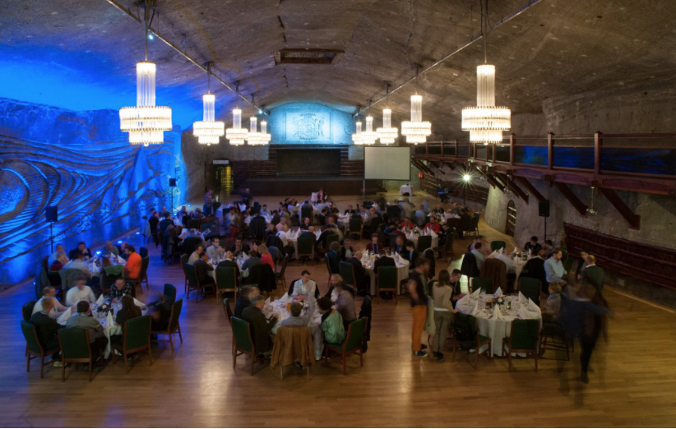
F-OSCARS – Forum Oscars
AMS-IX for the secretariat services for 12 years
INEX for their work on IXP Manager
NIX.cz on their continued work on BIRD
LINX –Malcolm for their regulatory affair contributions

Slide 10
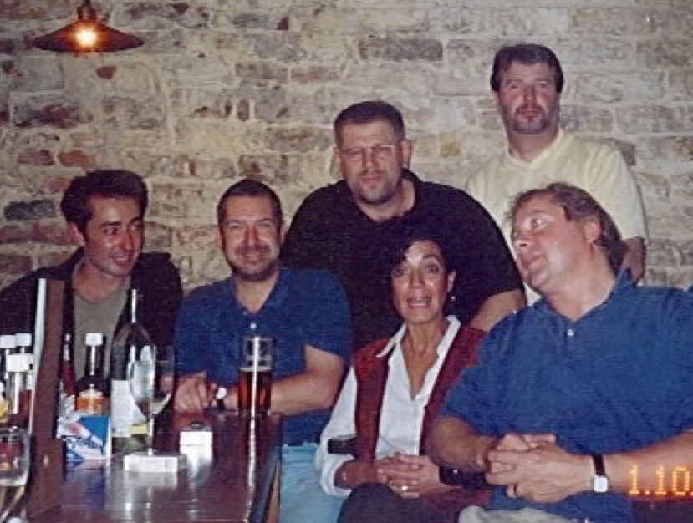
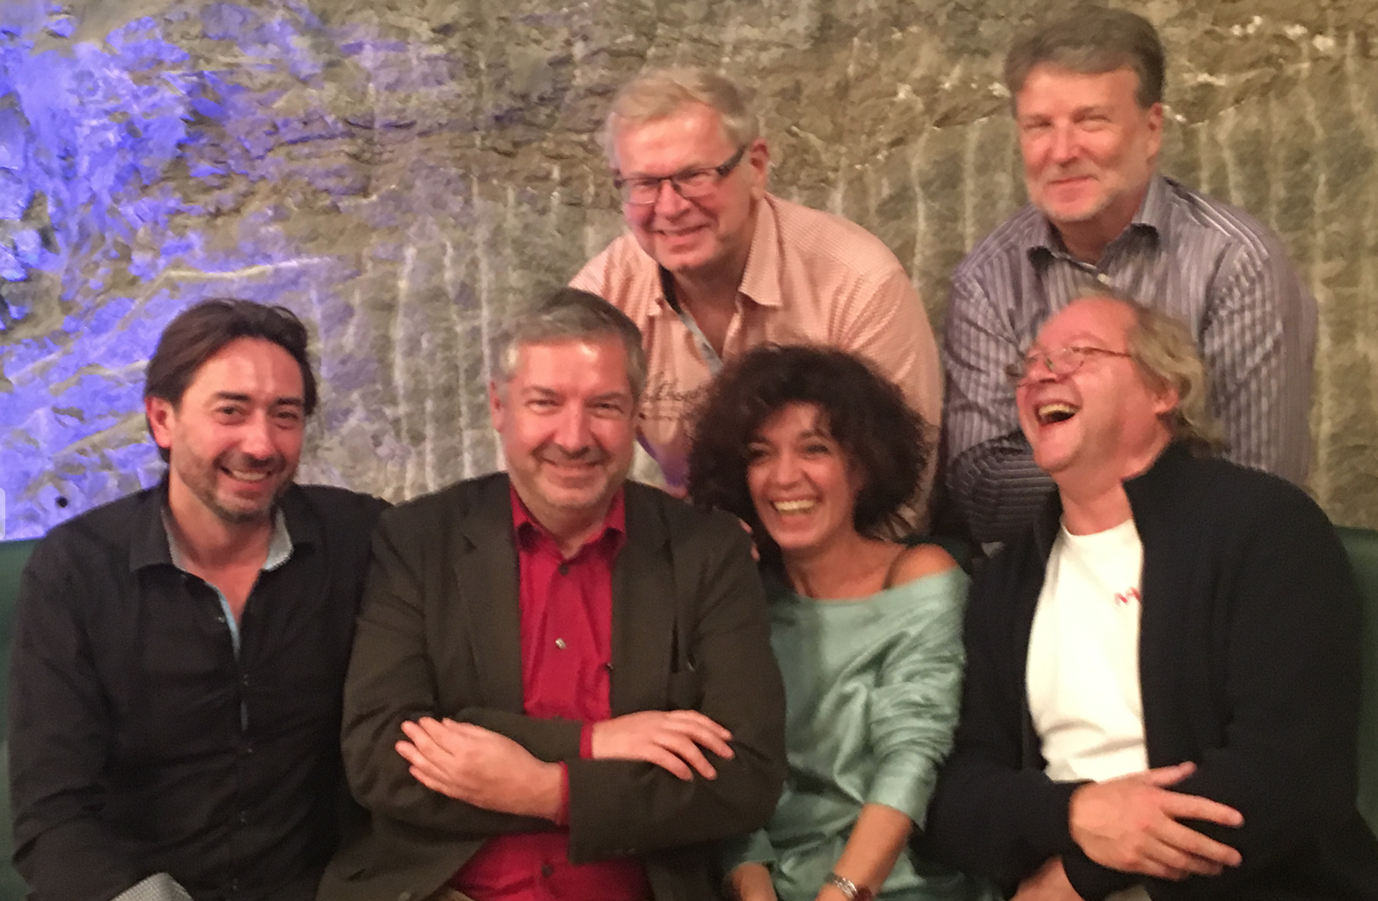
Celebrating 15 years of Euro-IX
2001
2016

Slide 11
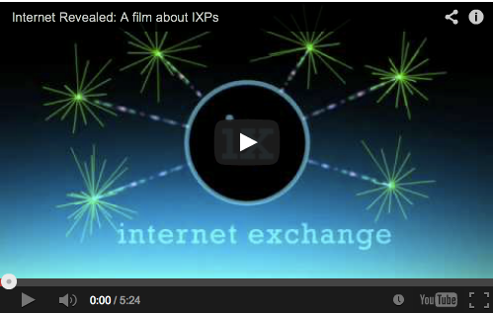
The Internet Revealed – IXP Movie
In English, Italian, German, French, Turkish, Spanish, Romanian, Portuguese, Arabic, Chinese, Russian and with Greek subtitles, check out our YouTube channel: youtube.com/channel/UCFyucVRAAMzxyJIsxnGwsjw

Slide 12
Thank You!

